Slide 1
Sales Analysis Project
End-to-End Data Analytics Project (2014–2021)
Prepared by: Top Boy

Slide 2
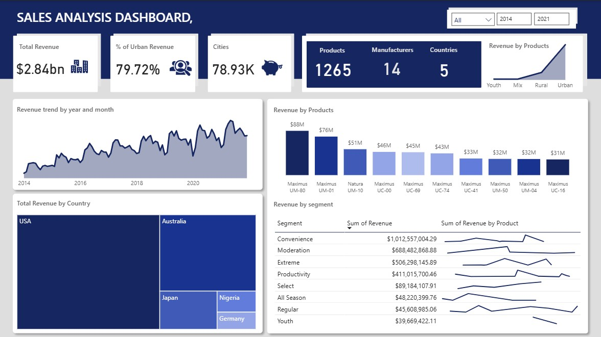
DASHBOARD OVERVIEW

Slide 3
PROBLEM STATEMENT 1
The company’s sales data from multiple countries (2014–2021) is stored across separate files with inconsistent formats, making it difficult to analyze overall performance. Because of this, the business cannot easily track revenue trends, compare countries, evaluate product and segment performance, or identify top manufacturers.

Slide 4
PROBLEM STATEMENT 2
To solve this, the project aims to clean and unify all sales, geo, manufacturer, and product tables, build a proper data model, and create a Power BI dashboard that clearly answers key business questions such as total revenue, top products, segment performance, urban vs. rural revenue, and year-to-year trends.

Slide 5
Project Overview
Goal:
Analyze multi-country sales performance to uncover revenue trends, top products, market behavior, and segment performance.
Tools: Power BI • Power Query • DAX • Data Modeling

Slide 6
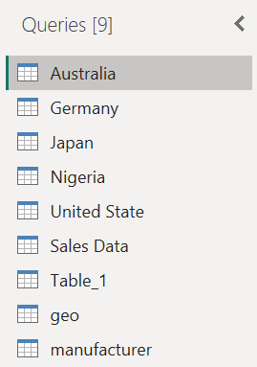
Data Collection & Merging
Imported Datasets:
Multiple country files → appended into Sales Data
Imported additional tables:
  Geo
  Manufacturer
  Table_01

Slide 7
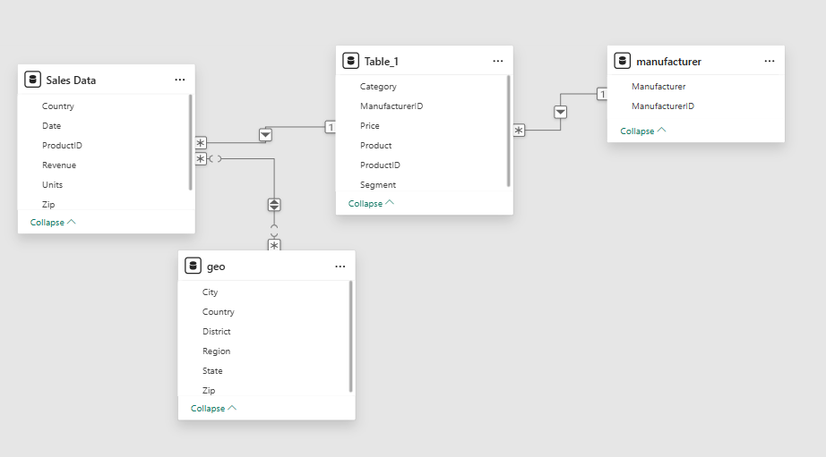
Data Collection & Merging
Relationship Setup:
Sales Data connected to:
Sales Data - Geo (*..*)
Sales Data – Table_01 (*..1)
Table_01 – Manufacturer (*..1)
Star schema structure created for optimal reporting.

Slide 8
Data Cleaning (Sales Data)
Cleaning Steps Performed:
Standardized country name:
  Changed "United state" → "USA"
Removed empty rows
Validated data types
Ensured correct revenue, date, and category formats
Outcome:
A consistent and unified Sales Fact Table ready for analysis.

Slide 9
Data Cleaning (Manufacturer & Geo Tables)
Manufacturer Table
Deleted empty rows
Transposed table
Removed empty rows again
Deleted redundant columns
(manufacturer logo, duplicate lists)
Used first row as header
Geo Table
Removed empty rows
Removed top row 1 (unnecessary labels)
Used first row as header
Split the City column → deleted
unwanted City.2
Renamed City.1
Removed empty rows in Country
Deleted unwanted countries

Slide 10
Data Cleaning (Table_01)
Table_01 Preparation Steps:
Filled down the Category column
Split (delimited) the Product column → created Segment field
Delimited the Price field → removed the USD prefix columns
Ensured data types are correct for all columns
Final Step:
Cross-checked ALL tables → validated data types → created relationships.

Slide 11
KPI Highlights
Revenue: 2.84bn
Urban Revenue %: 79.72%
Cities: 78.93K
Products: 1265
Manufacturers: 14
Countries: 5
Business Interpretation:
Urban markets dominate revenue contribution → opportunity in rural expansion.

Slide 12
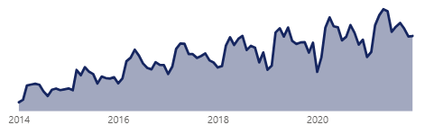
Revenue Trends & Patterns
Revenue Trend (2014–2021):
Strong upward growth
Seasonal dips but fast recoveries
2018–2021 show highest performance
Key Drivers:
Product launches
Regional promotions
Growth in high-value cities

Slide 13
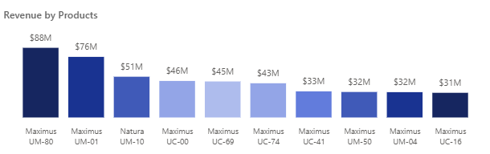
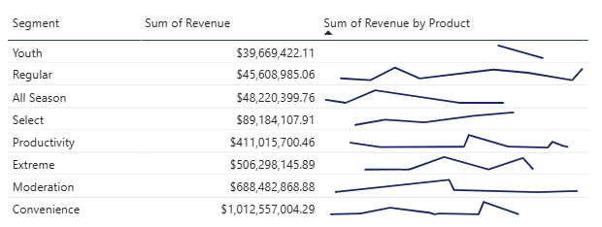
Product, Country & Segment Insights
Top Products
Maximus UM-80 (88M)
Maximus UM-01 (76M)
Natura UM-10 (51M)
Top Countries
USA (dominant)
Australia
Japan
Nigeria & Germany (growing potential)
Top Segments
Convenience — 1.01bn
Moderation — 688M
Extreme — 506M
Insight:
Convenience + Moderation ≈ 60% of total revenue.

Slide 14
Final Insights & Recommendations
Insights
Urban markets = primary revenue zone
Product portfolio heavily depends on Maximus line
Mid-tier products show strongest growth
Nigeria and Germany = emerging markets
Recommendations
Strengthen rural distribution strategy
Diversify product dependence
Invest more in mid-tier pricing
Expand marketing in high-potential regions

Slide 15
CONCLUSION
This sales analysis has identified key factors driving revenue performance across multiple countries and product segments. The data reveals that urban regions contribute the majority of total revenue (≈80%), highlighting the importance of focusing on high-density markets. Additionally, top-performing products, particularly the Maximus line, generate a disproportionate share of revenue, indicating that product-specific strategies can significantly impact overall sales.
Segmented analysis further shows that revenue is influenced more by product category and geographic location than by manufacturer count or country size alone. These findings suggest the need for targeted business strategies focused on:
Expanding high-performing product lines,
Prioritizing urban market penetration,
Monitoring emerging markets such as Nigeria and Germany for growth opportunities.
Going forward, integrating predictive analytics into the dashboard (e.g., revenue forecasting, seasonal trend modeling) could enhance the company’s ability to proactively optimize product investments, market expansion, and revenue growth.

